Slide 1

Optical Music Recognition
A Modern Machine Learning Challenge
Nancy Li | Mirza Nahiyan | Marcos Madrigal Albores | Saskia George

Slide 2
Outline
Introduction & Problem Statement - Nancy
Data & Data Processing - Marcos
Models & Results
Baseline - Marcos
CRNN - Mirza
Transfer Learning Model(s) - Nancy
Demonstration - Mirza
Conclusion & Takeaways - Nancy

Slide 3
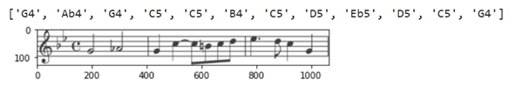
Introduction & Problem Statement
Problem: Transcribe sheet music
Reading sheet music requires specialized knowledge
A subset of image classification problem
Difficult because of numerous symbols and sequences
Notes:
explain the problem, give nuance of difficult

Slide 4
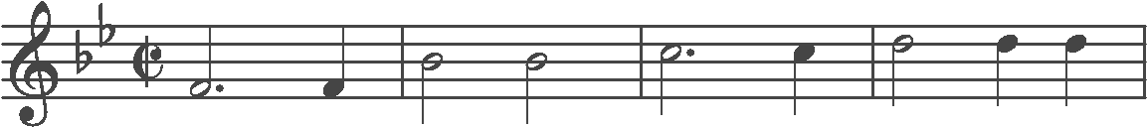
The Data
PrIMuS dataset: each piece of data has 1) a png and 2) semantic label
clef-G2 keySignature-BbM timeSignature-C/ note-F4_half. note-F4_quarter
Huge dataset with over 40k samples
Organized in folders for each sample; tedious to handle and upload
Both the labels and the pngs are of varying sizes; multi label sequence OMR problem
3 channel images even though the images are black and white

Slide 5
Data Processing and Data Loaders
Our goal with the preprocessing of our data was to have data loaders as in the laboratory exercises to simplify our approach
We standardized the image size to 154 x 1200 pixels by using padding
We used 2k sample to train the model
Tried creating a dataset with no sharps, but stuck to the original 2k samples
Repeated integer encoding due to massive label possibilities (example, a B flat and C # are the same note)
The relevant note labels use integer encoding
The final data and labels are turned into pytorch tensor dataloaders

Slide 6
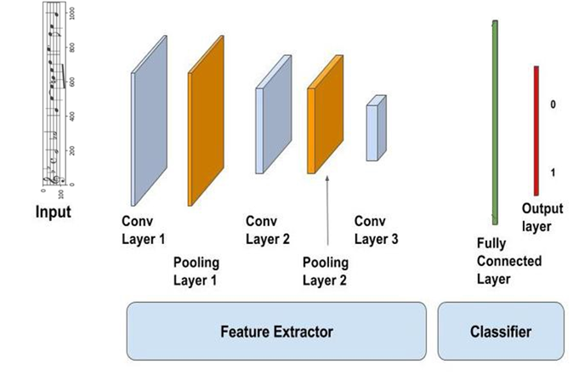
Baseline Model
Standard CNN to highlight the importance of the architecture of our model and existing solutions
3 Convolutional Layers
2 Max Pooling Layers
Same input as main model
MSE loss due to the multi label sequence
Labels and data of a standard size

Slide 7
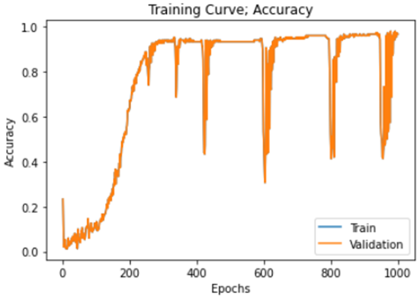
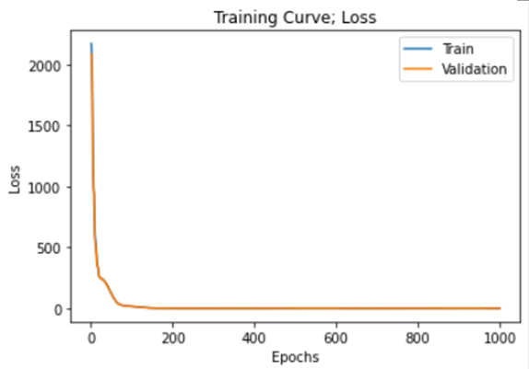
Baseline Model: Overfitting (Validation = Training)
Final Accuracy 0.9666
Final Loss 0.05477

Slide 8
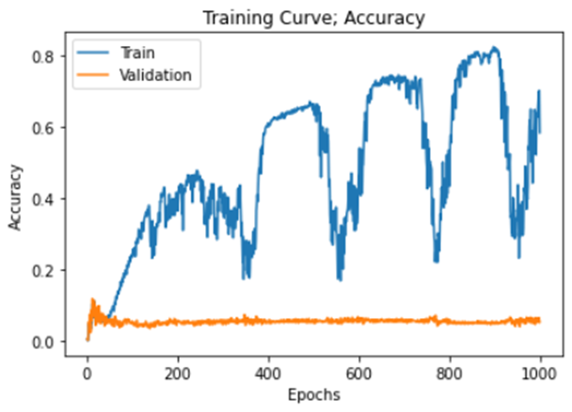
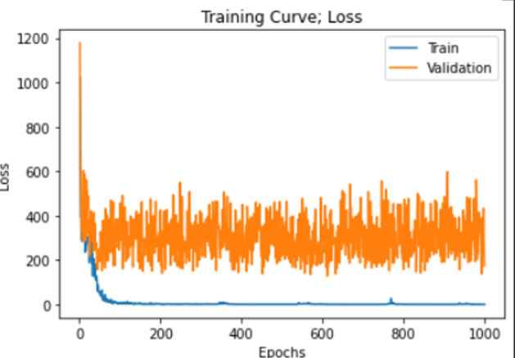
Baseline Model: Small Dataset
Final Training Accuracy 0.585185
Final Validation Accuracy 0.054629
Final Training Loss 0.3312
Final Validation Loss 173.6244

Slide 9
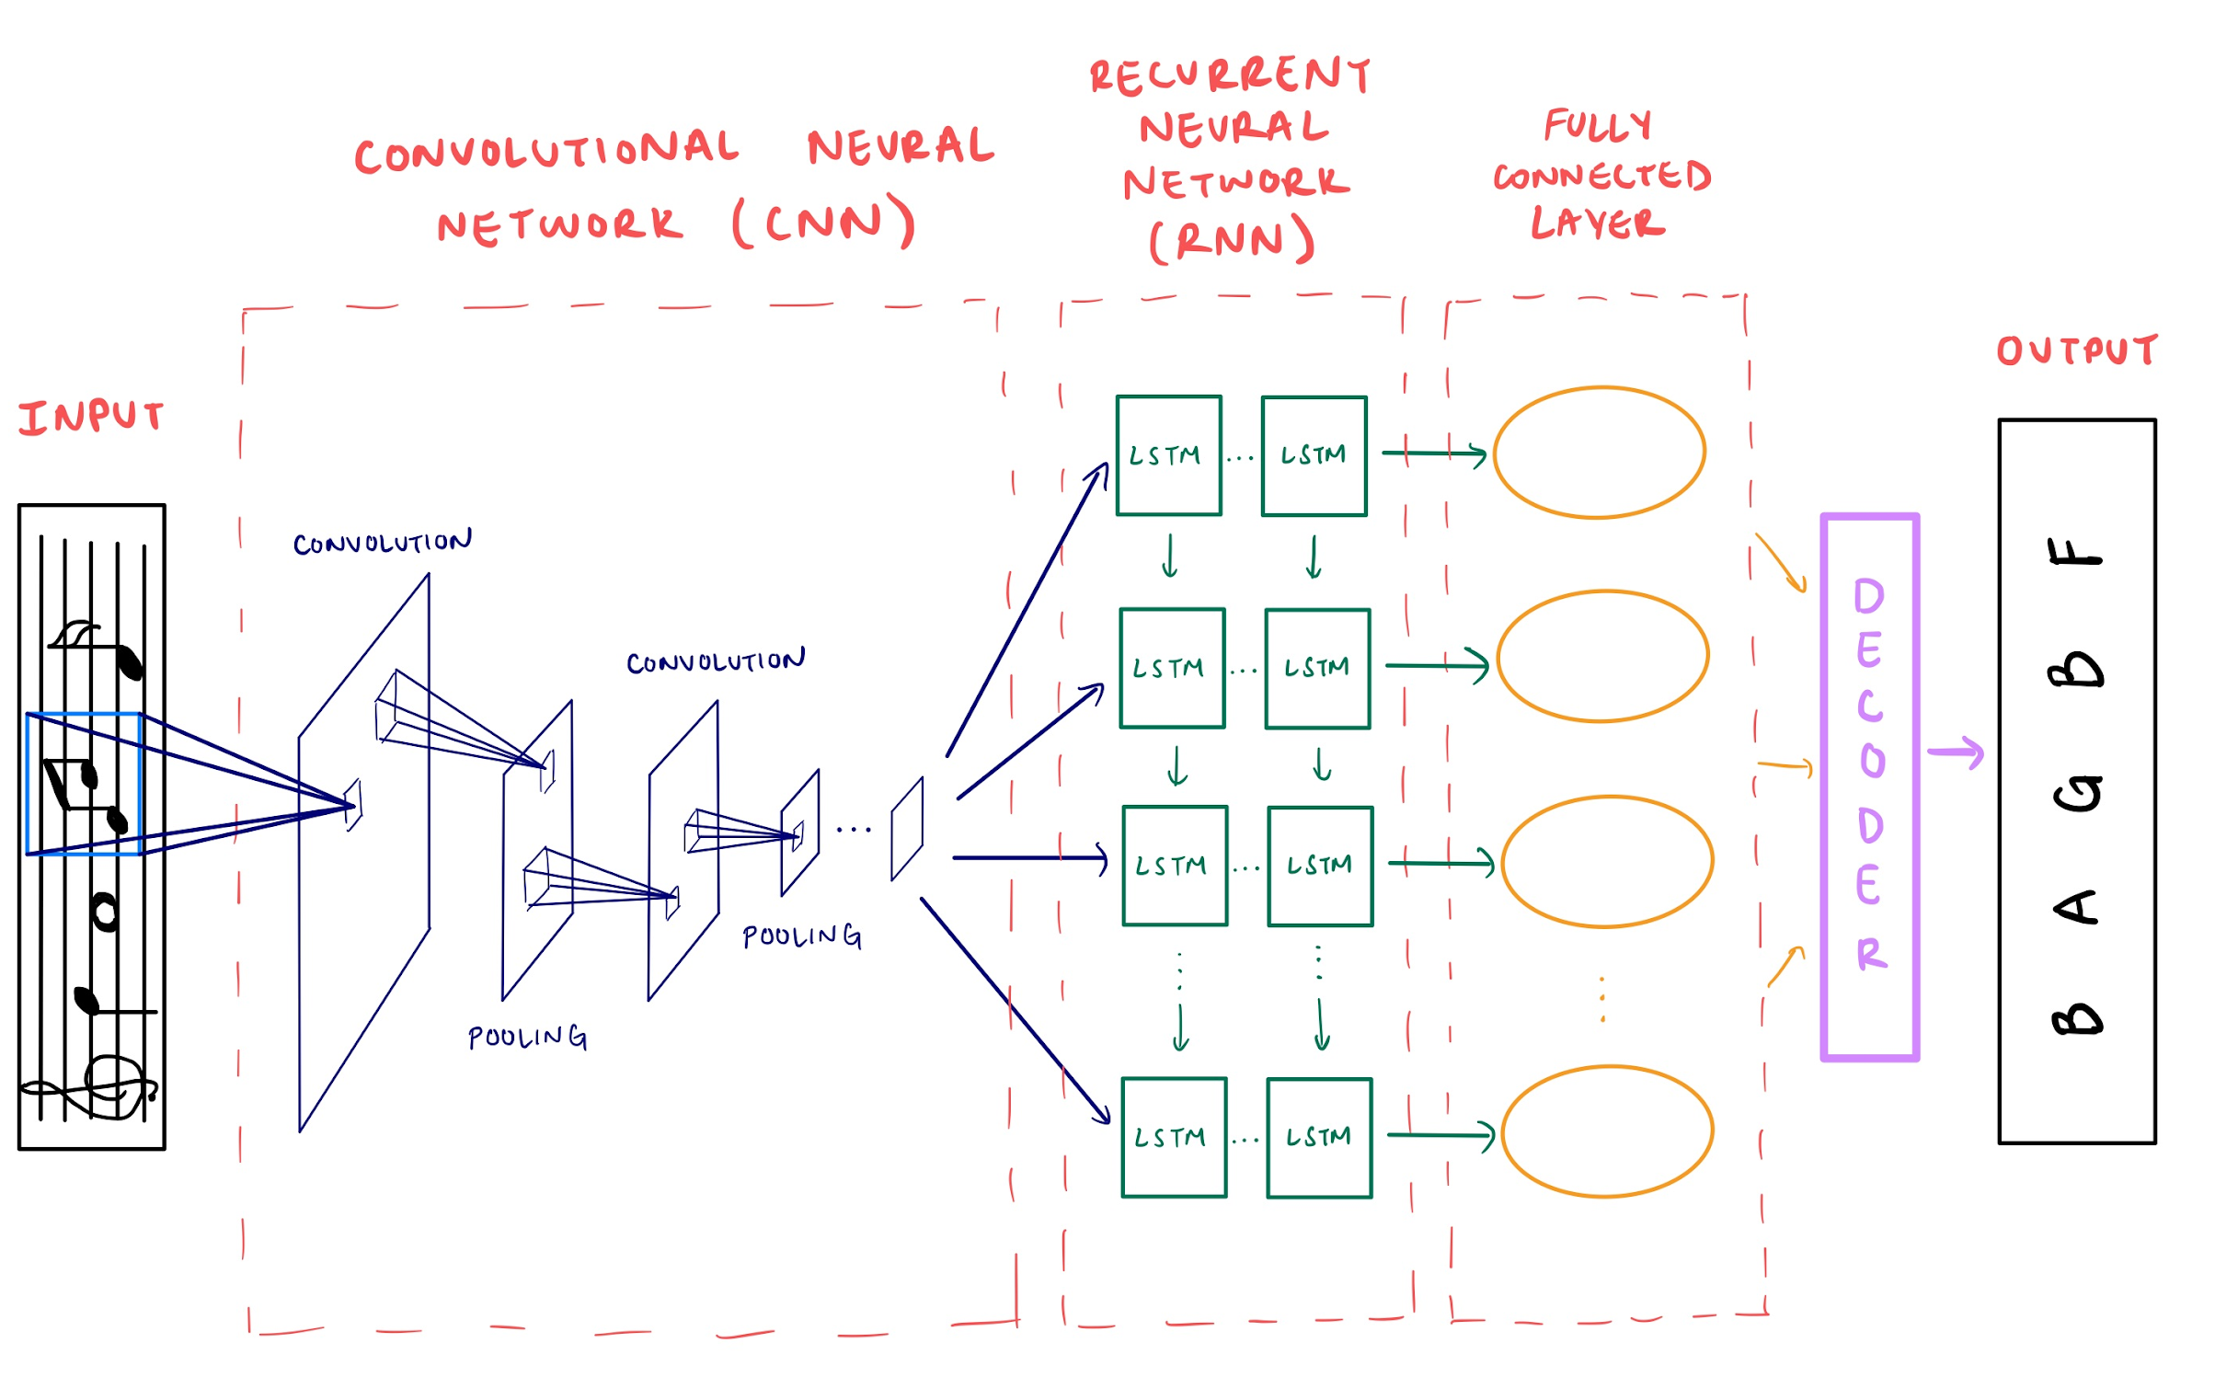
Convolutional Recurrent Neural Network (CRNN) Model
Architecture:
4 convolutional layers
3 max pooling layers
ReLU activation function and batch normalization applied after convolutional layers
3 bidirectional Long Short-Term Memory (LSTM) layers
1 fully connected layer for classification
Training:
Logarithmic Softmax applied to output
Connectionist Temporal Classification (CTC) Loss function
Adam Optimizer
Notes:
The next model we built was a Convolutional Recurrent Neural Network where the feature extraction is done in the CNN part, the sequence detection in the RNN part and the classification in the fully connected layer, as shown on the diagram to the right.
The CNN has 4 convolutional layers with a ReLU activation function and batch normalization applied after each one as well as 3 max pooling layers between them.
The output of the CNN is then passed to the RNN which is made up of 3 bidirectional LSTM layers that allows the model to better predict the output since it has a more thorough understanding of the context for one note in the sequence using information from the past and future.
The last layer is the fully connected layer which is used to make a prediction on each column of the convoluted image.
This results in a complicated output that is much larger than the label length and contains many repeated notes, which requires a loss function that can make sense of it.
The CTC Loss is really good at doing exactly that so we used it and an Adam optimizer to train the model after applying a softmax to the output.

Slide 10
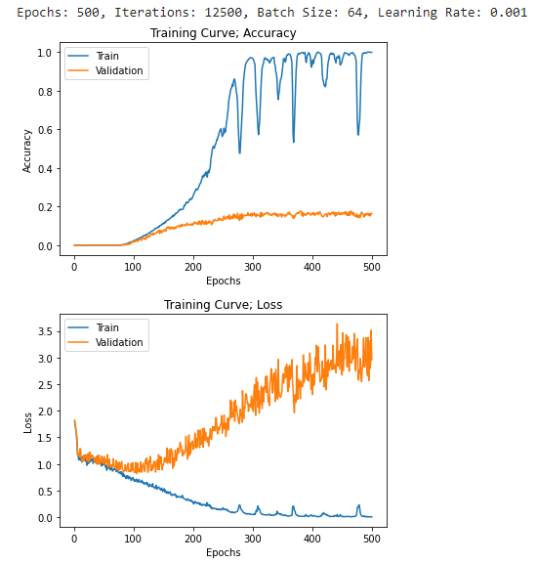
CRNN Model’s Quantitative Results
Accuracy was computed based on how many notes were predicted correctly within each label of the dataset.
After training on ~1600 images we achieved the following results:
Training accuracy: ~99%
Validation accuracy: ~17%
Test accuracy: ~16%
Notes:
This allowed us to train our model and produce the training curves below.
We chose to compute accuracy as the number of notes predicted correctly within each label, in other words the percentage of correct notes in the right places, to help us better understand how the model was performing.
After training on around 1600 images, our best results for this model were a training accuracy of 99% and a validation accuracy of 17%.
We then tested this model and achieved a 16% testing accuracy.

Slide 11
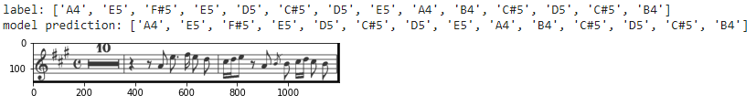
CRNN Model’s Qualitative Results on Training Data
Sample decoded output from training data:
Accuracy: 100%
Notes:
To better visualize our results, this is a sample decoded output from the training data. As you can see, our model achieved an accuracy of 100% on this image.

Slide 12
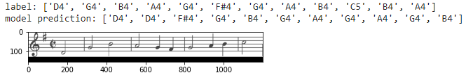
CRNN Model’s Qualitative Results on Validation Data
Sample decoded output from validation data:
Accuracy: 16.7%
Notes:
As a more representative sample, this is our model’s output on an image from the validation set where our model achieved an accuracy of 16.7%

Slide 13
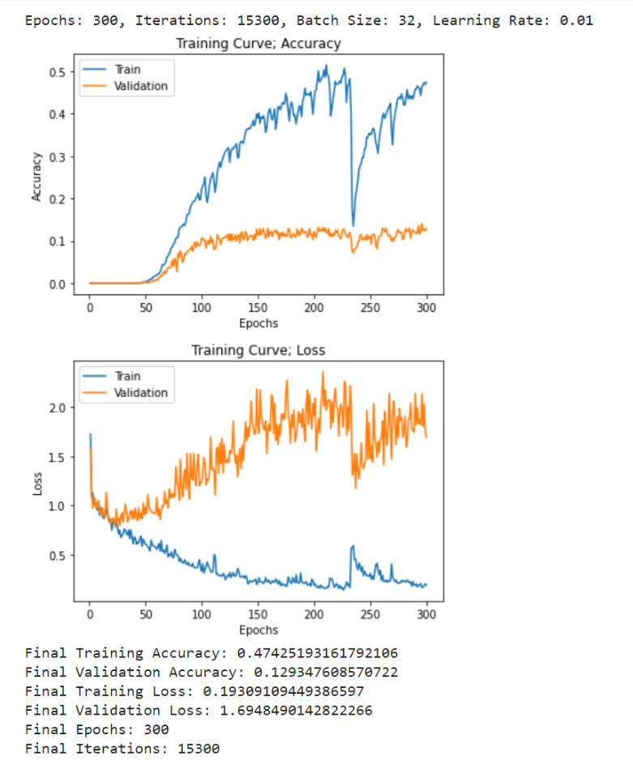
Transfer Learning Model(s)
Replace CNN layers with pretrained CNN models:
VGG-11 with batch normalization
Bidirectional, 2 LSTM layers, dropout = 0.4
Characteristics:
Overfitting
Training accuracy ~ 48%
Validation accuracy ~13%
Testing accuracy ~12%

Slide 14

Demonstration on “Someone You Loved” - Lewis Capaldi
Retrieving and resizing image to 154 x 1200 pixels
Notes:
To demonstrate our model’s performance on new, never before seen data we chose part of a song released after the PrIMuS dataset was created.
The song we chose was Someone You Loved by Lewis Capaldi, released in 2019.
We first processed the image by resizing it to be 154x1200 pixels.

Slide 15
Feeding New Image to Model
Notes:
We then fed the image to the model and decoded the output.

Slide 16
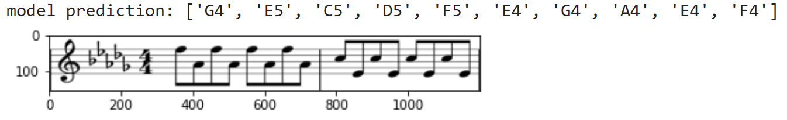
Results of Demonstration
Song: Someone You Loved - Lewis Capaldi (2019)
Actual notes: [‘F5’, ‘Ab4’, ‘F5’, ‘Ab4’, ‘F5’, ‘Ab4’, ‘F5’, ‘Ab4’, ‘C5’, ‘E4’, ‘C5’, ‘E4’, ‘C5’, ‘E4’, ‘C5’, ‘E4’]
Accuracy: 6.25%
Notes:
These were our results. As you can see, the model obtained a 6.25% accuracy on this image.

Slide 17
Conclusion & Takeaways
Poor performance
Obstacles:
Data loading was difficult due to the limit of RAM size
Could not increase the complexity of CRNN due to the limit of GPU memory
Hardware limitations
Notes:
couldn’t increase complexity of CRNN model too much because we didn’t have enough GPU memory to train it on that

